Slide 1


Slide 2
Why are we here?

Slide 3

Why are we here?
1. To do great science that is fascinating at a basic level, but has enormous applied value to society as well
2. To improve and develop our own skills and knowledge
The research agenda of the NDC Lab focuses on cognitive control, guided by three inter-related questions:
What is cognitive control (across three levels of analysis)?
How does cognitive control develop (across adolescence)?
How does cognitive control relate to social behavior and social anxiety?

Slide 4

2. To improve and develop our own skills and knowledge

Slide 5
To improve and develop our own skills and knowledge
You are an end in and of yourself
Your time in the lab should not only be:
A time where you collect data carefully to give us the best chance of making discoveries
A time where you help create tools to enable discoveries
A time where you help to design or even lead a research study
You should
Discover/refine the career path you want to pursue
Learn/refine the knowledge and skills needed for the next step in your career
Receive credit and recognition for the your contributions

Slide 6
1. To do great science that is fascinating at a basic level, but has enormous applied value to society as well
What is cognitive control (across three levels of analysis)?
How does cognitive control develop (across adolescence)?
How does cognitive control relate to social behavior and social anxiety?

Slide 7
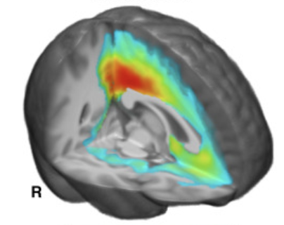
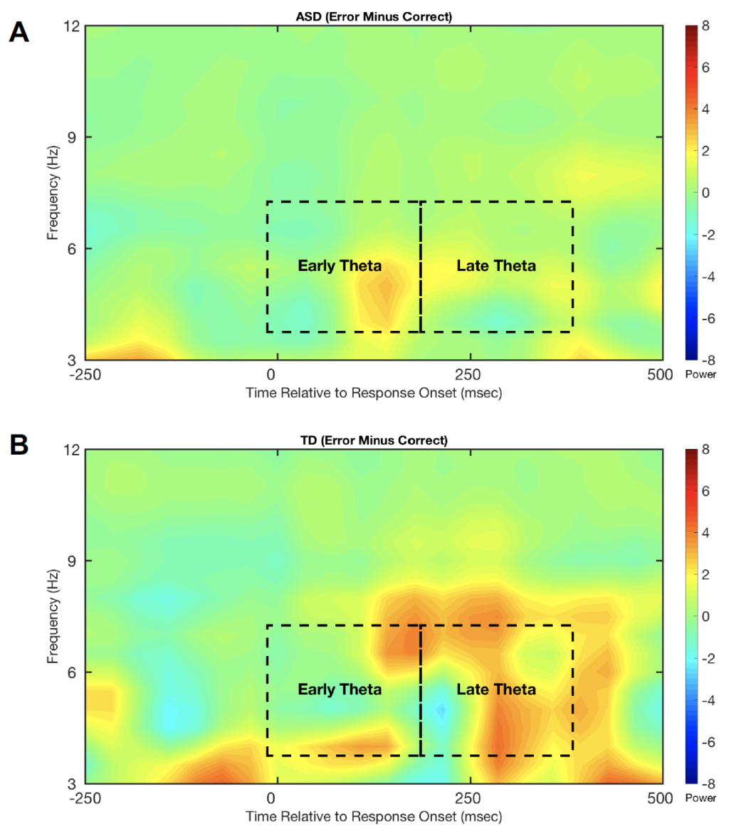
What is cognitive control?
The ability for the human mind/brain to monitor and adapt/control itself over time
Two basic parts:
Monitoring: detecting events that might signal a need for control
Control instantiation: top-down control over brain an behavior in the service of achieving task goals
Three levels of analysis:
Behavioral
Computational
Neural

Slide 8
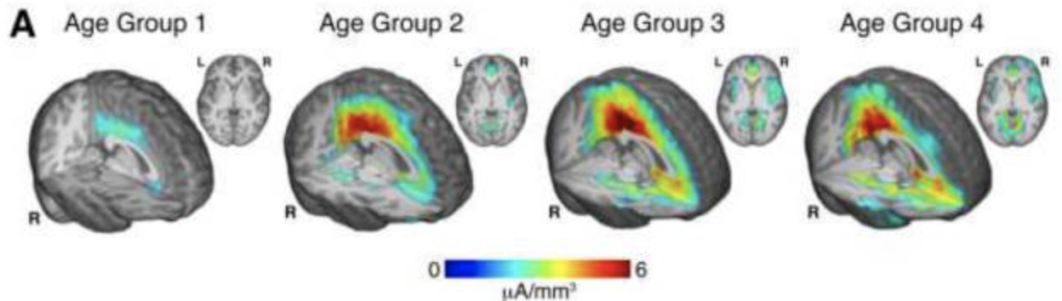
How does cognitive control develop?
Broad changes in cognitive control occur from infancy to adulthood
Adolescent development is more nuanced and complex
How do such changes relate to other factors?

Slide 9
Relations to social behavior and social disorders?
Changes in the social world and a spike in social anxiety during adolescence
How do individual differences in cognitive control relate to social behavior and social anxiety?
Do differences in cognitive control development predict the emergence of social anxiety?
Relations to other social disorders (autism)?

Slide 10
How do we do our work?

Slide 11

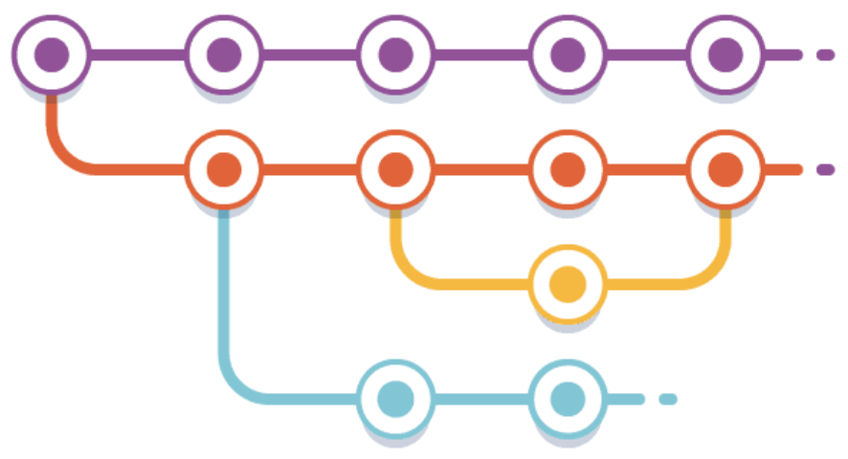


The NDCLab is an “Open Lab”
As much as possible, all our work is conducted publicly
We encourage contributions from non-members
As much as possible, the provenance of all intellectual work is tracked to facilitate proper recognition for contributions
Towards these ends, we leverage public GitHub repos and public Google Drive folders as much as possible in our work

Slide 12
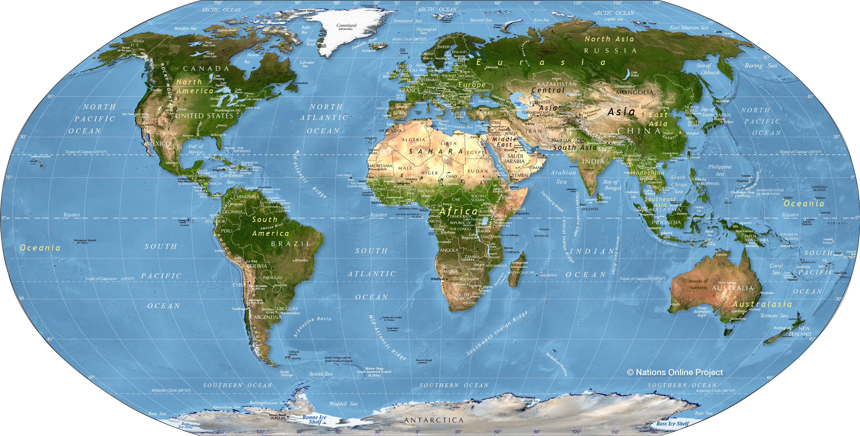
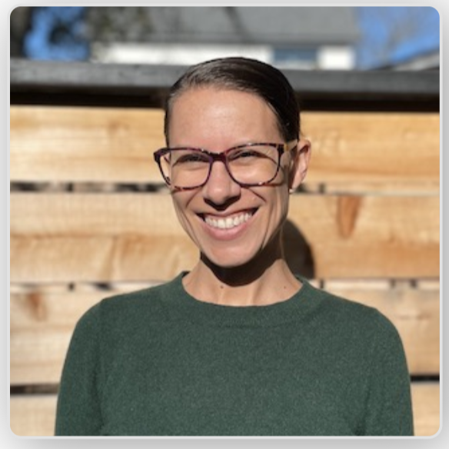
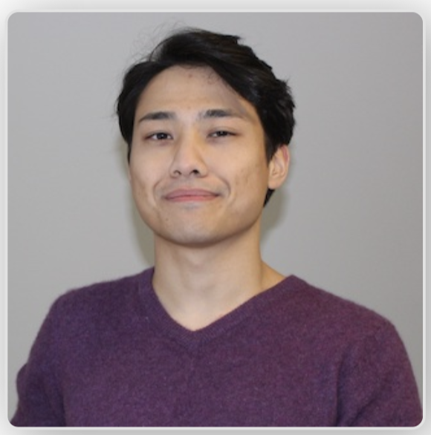
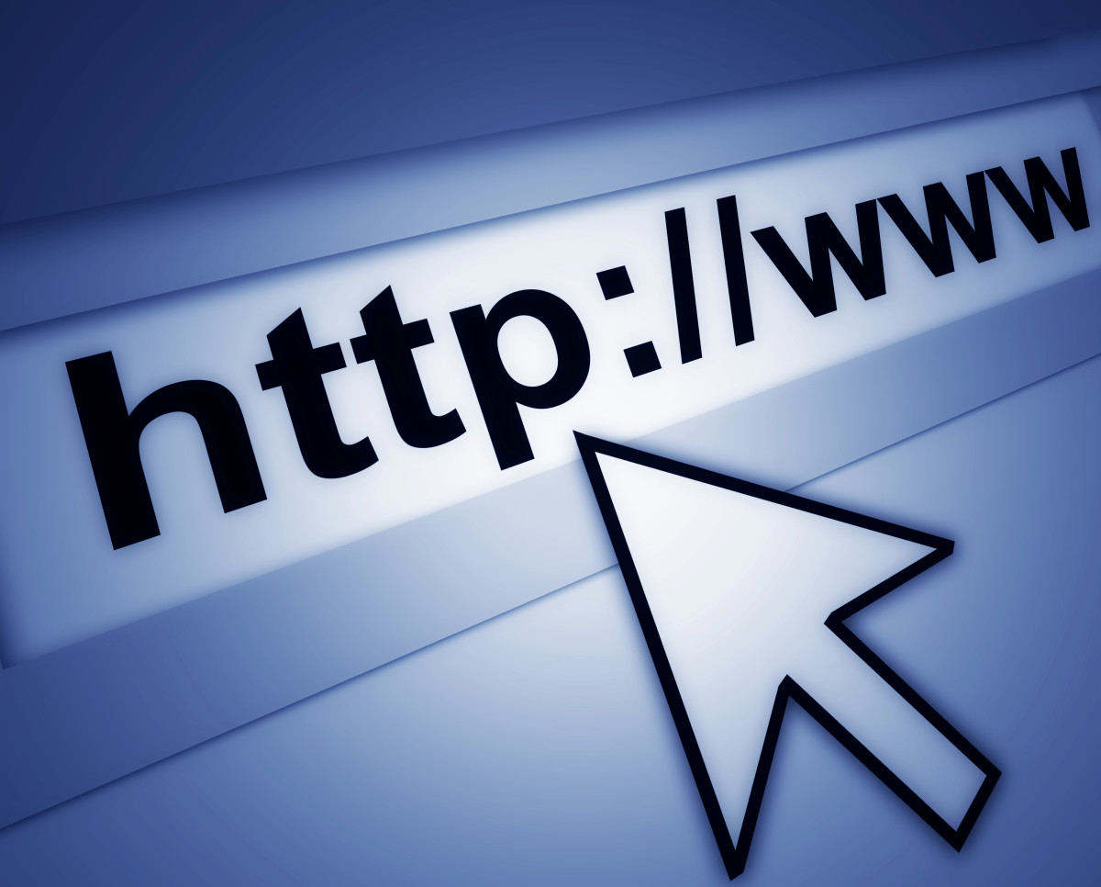



The NDCLab is a “Hybrid Lab”
The NDCLab was born online and operates in a hybrid format
Lab members and/or external contributors need not be physically present on the FIU campus
Lab members need not reside in the US!
Our Lab manager and Lab Technician are both fully remote
We run studies both online and in person
We leverage online platforms to maintain communication and team cohesion
Good communication is crucial to being an NDCLab member
Must be able to work both independently and as part of a hybrid team

Slide 13

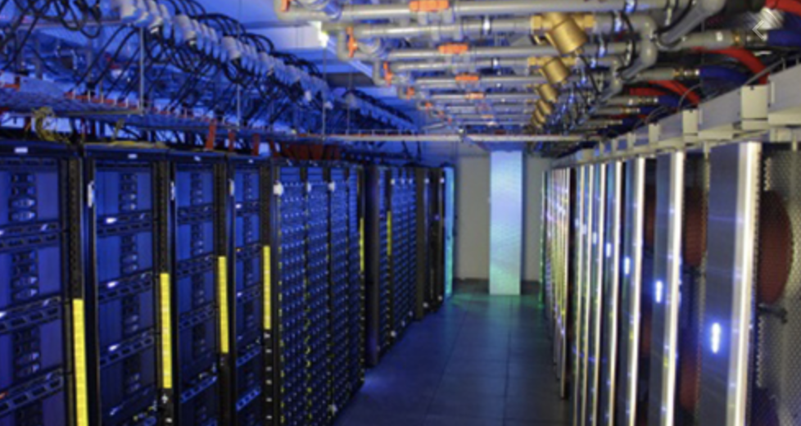





“Structure” of lab
Lab space in DM
Data collection rooms in AHC4/5, PG5
HPC
GitHub, Google Drive
Slack, Zoom
Weekly lab meeting (hybrid)
Bi-weekly EEG working group (hybrid)
Bi-weekly Analysis working group (hybrid)
Project-specific meetings (hybrid)
Sprint Meetings every 2-3 weeks
Ad-hoc working meetings
Weekly (digital) check-ins
Slack/Zoom/call/text/ PI anytime (open-door policy)
Never hesitate to contact me, I will respond as soon as I can

Slide 14
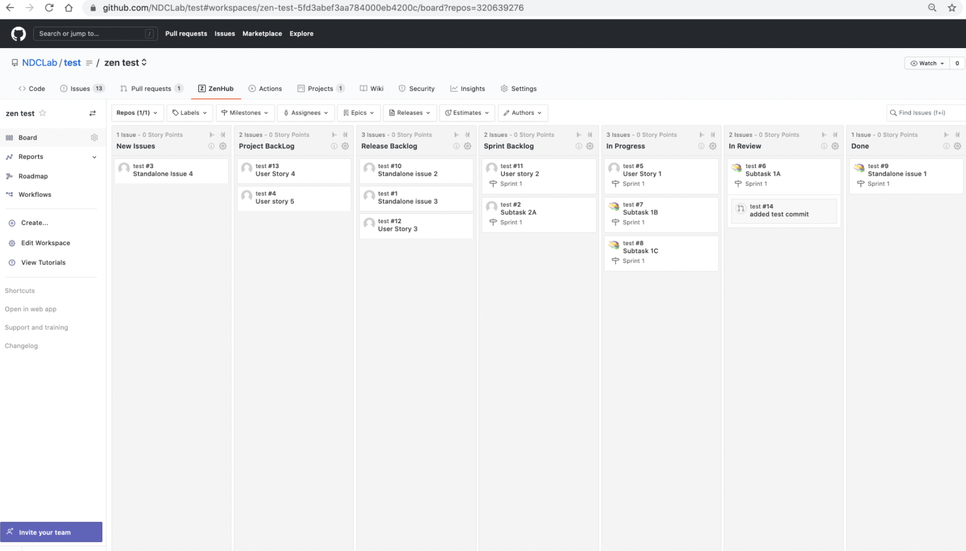
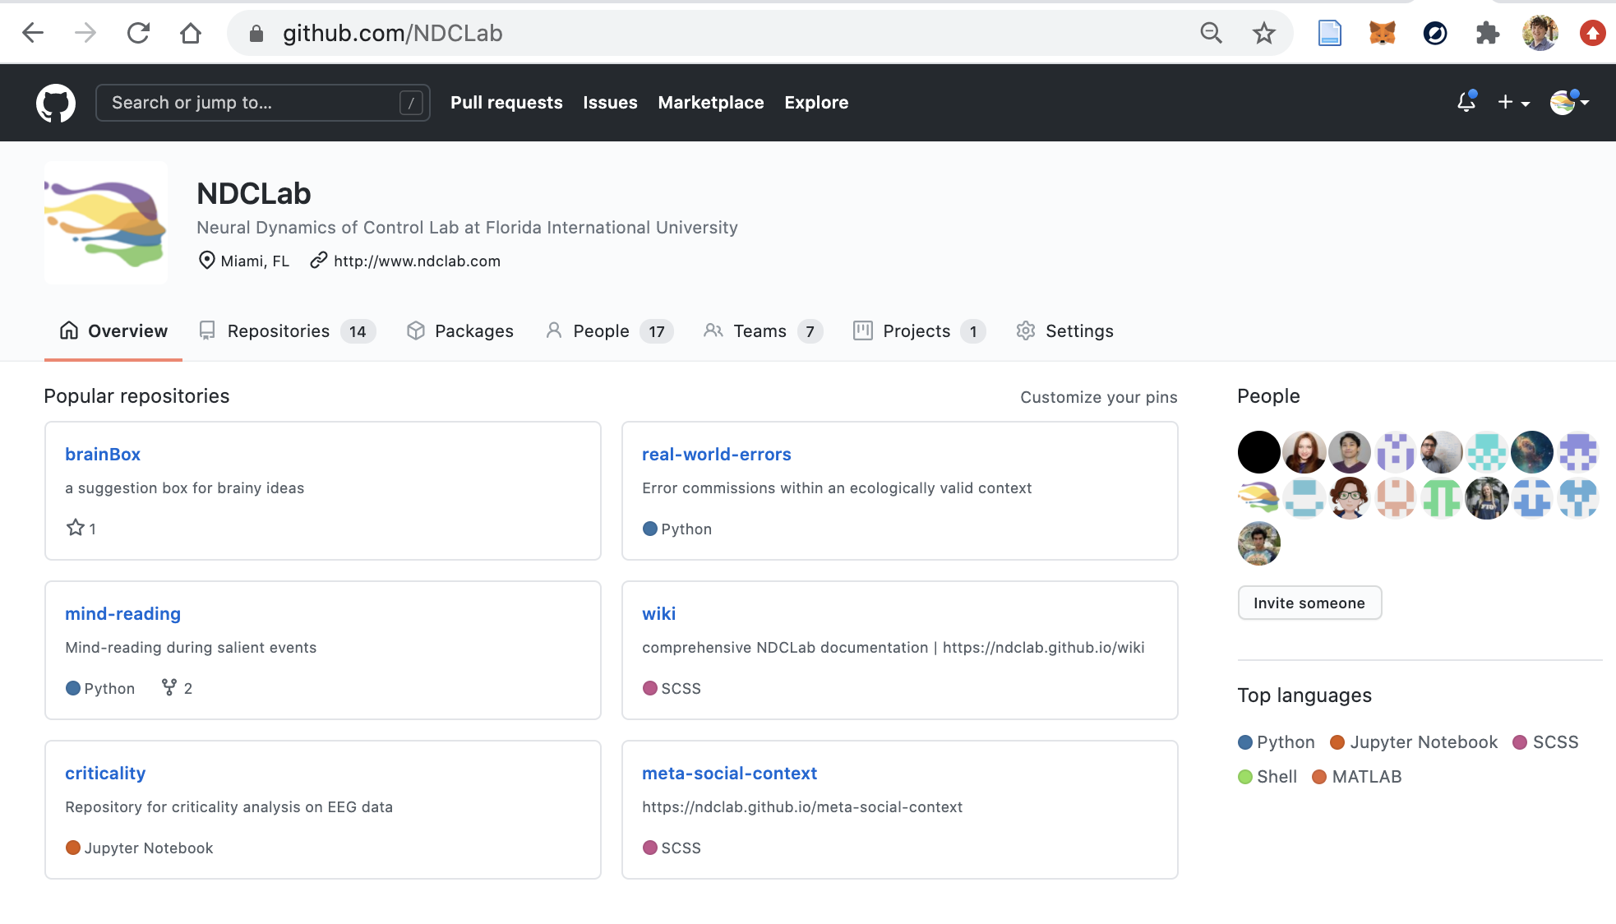
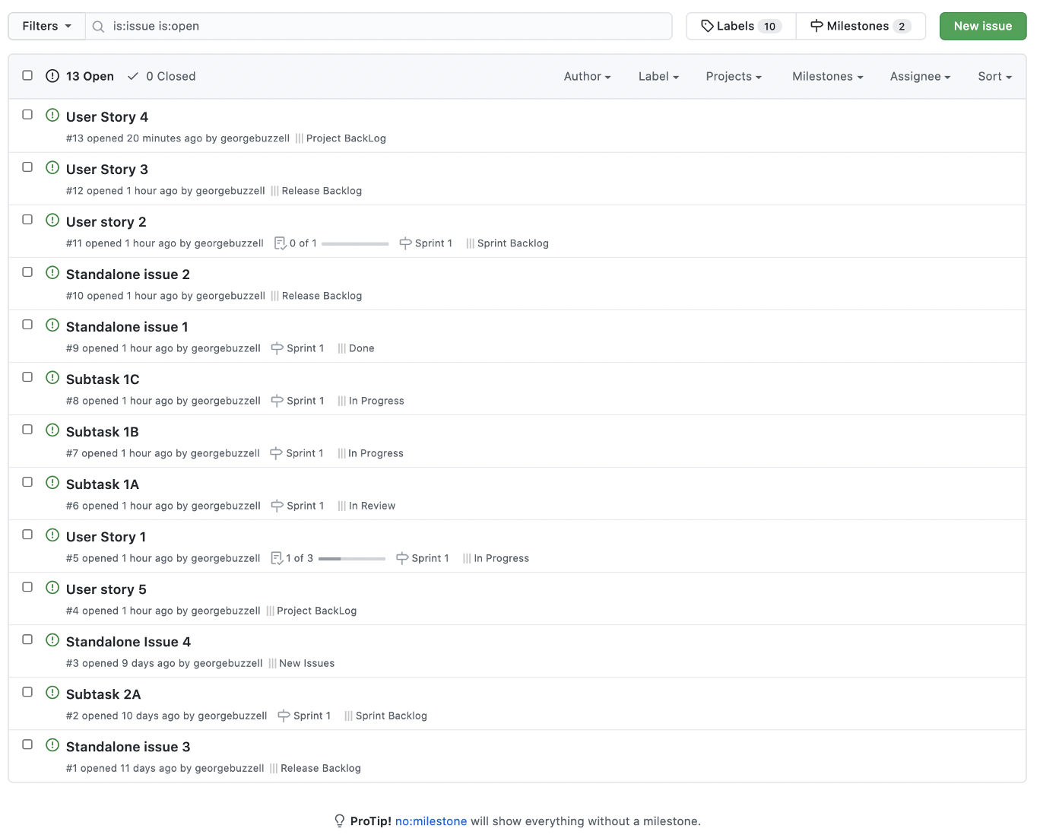
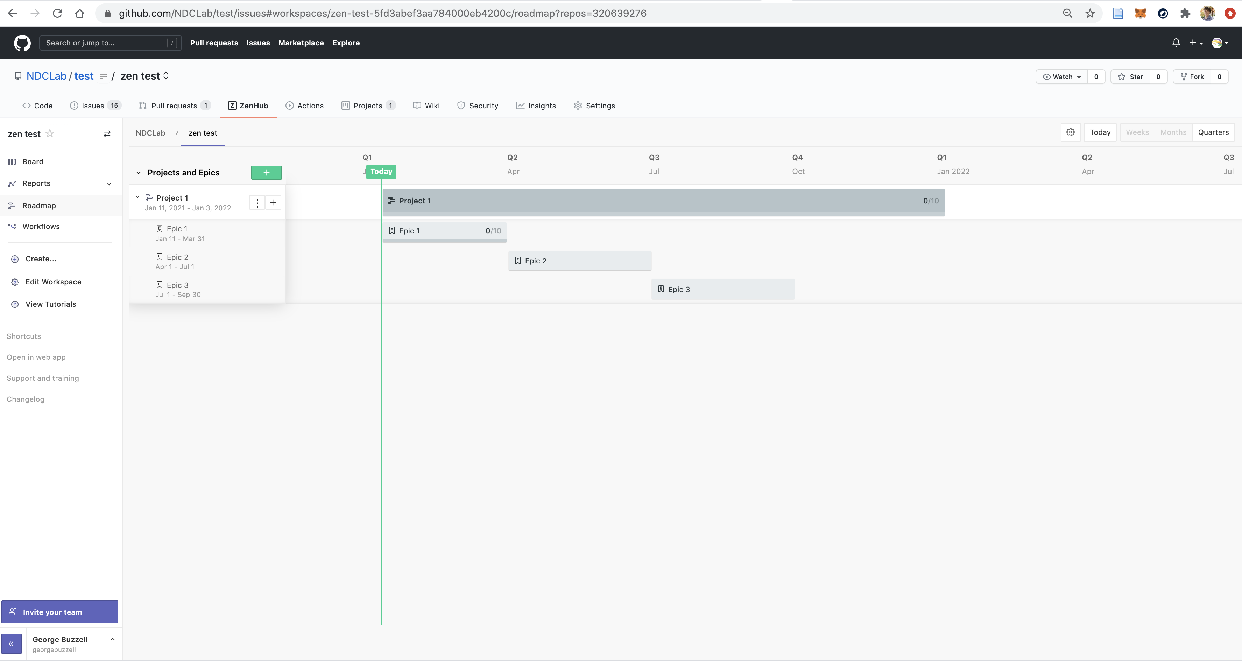
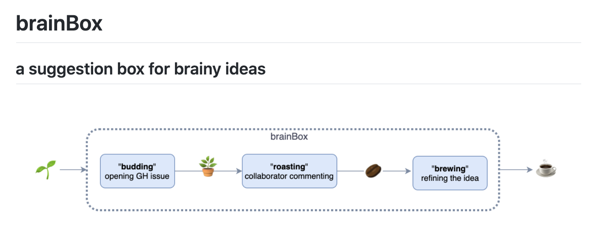
Dynamic collaboration and Planning on GitHub

Slide 15
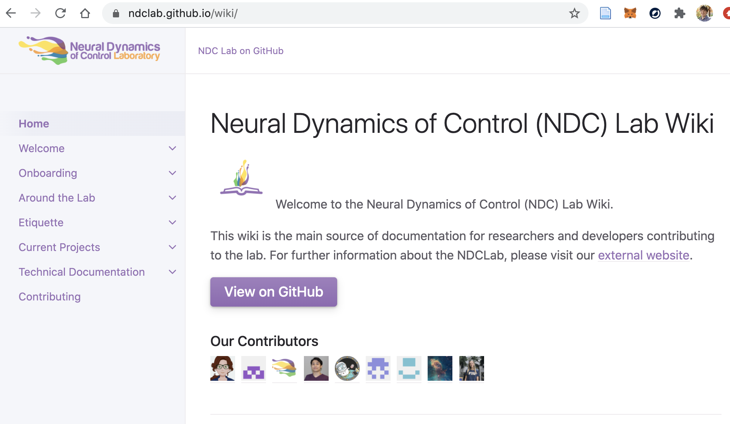
You are not alone; The NDCLab Wiki is here for you!

Slide 16
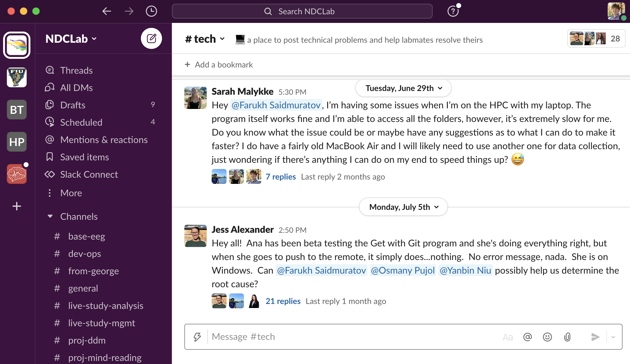
You are not alone; The NDCLab Slack is here for you!

Slide 17
Roles & Expectations

Slide 18
What you can expect from me (lab-wide level)
Ensure that the NDC Lab remains a positive, inclusive and supportive environment where we can:
“Do great science that is fascinating at a basic level, but has enormous applied value to society as well”
“Improve and develop our own skills and knowledge”
Set the larger research agenda and priorities for the lab
Ensure the lab has the people and resources it needs to run smoothly and achieve our goals
Foster collaboration, communication, and celebrate differences.
Communicate larger context of any given task
Remove roadblocks to execute task in line with your/lab’s priorities
Honesty and transparency

Slide 19
What you can expect from me (Individual-level)
To the extent that you take initiative and contribute to the NDCLab, you can expect a lifelong commitment to your academic and career growth.
You are all now integral members of the NDC Lab
You are the NDC Lab
You are future life-long alumni of the NDC Lab
Match your strengths and skills to impactful roles and experiences
Recognize your for your contributions (did someone say “authorship?”)
Provide mentorship/connections to help you navigate academia or a non-academic careers
Provide direct, one-on-one theoretical, technical, and practical training where appropriate
But also: point you in the right direction to facilitate your “learning how to learn”
Motivate you when you lose sight of the bigger picture
But also: have frank conversations about the diversity of academic/career paths possible

Slide 20
What we should all expect of each other
Each person or team’s success is the success of the NDC Lab as a whole
The more individual lab successes, the more the lab gains prestige, and your membership in the lab increases in value. The more my letters of rec carry more weight for you…
Mentor/help each other. Support and lift each other up
Learn from/with each other
Culture of open communication. Open with own strengths and weaknesses. Pre-empt potential conflicts through open dialogue.
As much as possible, ask all questions, have all discussions and make important decisions openly
Accountable for the tasks we say we will accomplish, by the time we say we will accomplish them
Or, constant, honest, open communication about roadblocks/challenges and delays
Timely responses to lab members, at earliest convenience
Take initiative. Do not wait to be told what to do, find/suggest things to do.

Slide 21
Community Standards

Slide 22
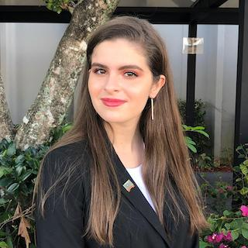
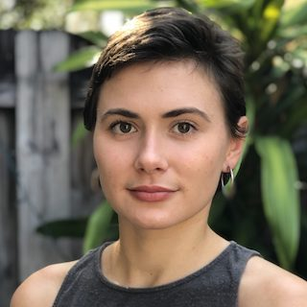
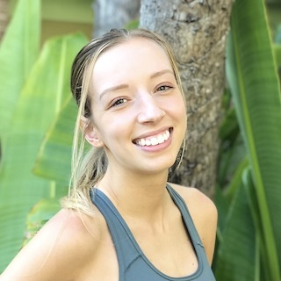
Emily
Arina
Sarah

Slide 23

Openness
We seek to be open-minded and curious. This means we listen to new ideas, celebrate differences, and operate with humility.
The importance of diversity
A two-sided coin
Listening to what others have to say
Sharing your ideas openly

Slide 24

Openness
We believe in open, transparent, and reproducible science, and we demonstrate these beliefs in the honest and transparent way that we conduct our work.
Clear communication every step of the way
Communicating our successes, failures, suggestions, and questions
Open science framework
Openness is a powerful tool that opens doors and invites collaboration

Slide 25

Accountability
We operate with integrity in order to merit the trust of our colleagues, protect the rights of our participants, and uphold public trust in science.
Acknowledge mistakes
Produce credible research (literature review, methods, etc.)
Complete necessary training
Employ best practices to ensure protection of research participants (informed consent, confidentiality, storage of data, debriefing, etc.)

Slide 26
Accountability
We fulfill the promises we make to one another.
Attending scheduled meetings
Maintaining open communication
Advanced notice
Completing tasks in a timely manner

Slide 27
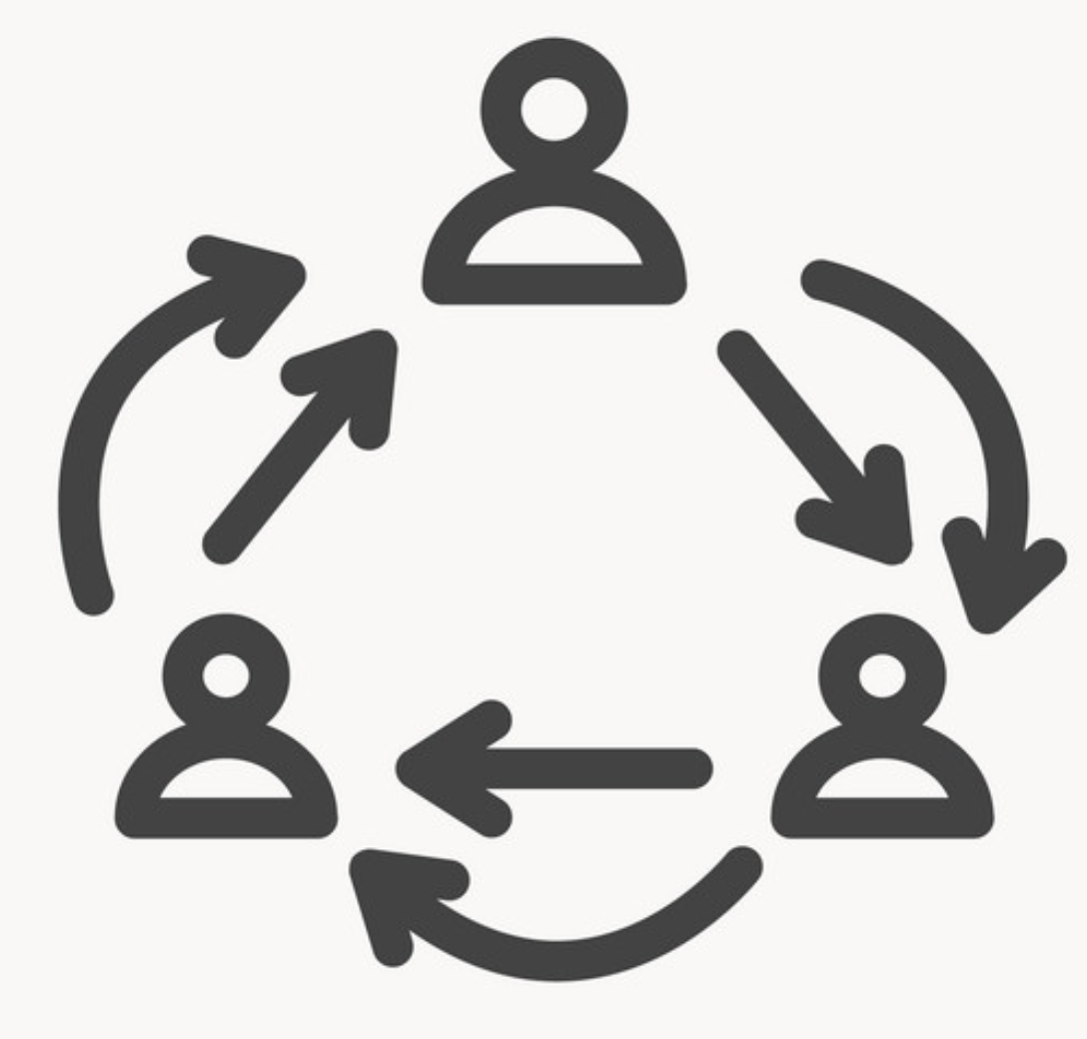
Respect
We demonstrate professionalism in all our interactions with colleagues, participants, and administrators to acknowledge the value of their time and contributions.
Kindness, courtesy, politeness
Responsive to one another
Offer feedback
Different commitments
Share valuable ideas

Slide 28
Questions?

